Slide 1


END SEMESTER PROJECT REVIEW
Traffic Control Management System
PRESENTED BY:
NAME : SIBIRAJ S
SUBJECT CODE : CGB1201
SUBJECT NAME : JAVA PROGRAMMING
REGISTER NUMBER : 927624BAD094
YEAR & SEC : II & B
DEPARTMENT : B . Tech(AIDS)
DATE : 13-12-2025

Slide 2
TABLE OF CONTENT
S.NO | TITLE | PAGE.NO
1 | ABSTRACT | 3
2 | INTRODUCTION | 4
3 | PROBLEM STATEMENT | 5
4 | SYSTEM ARCHITECTURE | 6
5 | SYSTEM ARCHITECTURE DESCRIPTION | 7
6 | LIST OF MODULES | 8
7 | LIST OF MODULES DESCRIPTION | 9
8 | RESULT | 11
9 | DISCUSSION | 13
10 | CONCLUSION | 14

Slide 3
ABSTRACT
This project is a Java desktop application made using AWT and Swing.
It simulates traffic signals and shows how traffic moves at junctions.
The system controls signal timing to manage traffic flow smoothly.
It gives congestion alerts when too many vehicles are on the road.
It can also suggest better routes to avoid traffic.
A simple dashboard is provided to view signals and reports.
The goal is to show how technology can help reduce traffic congestion and improve traffic management.

Slide 4
INTRODUCTION
Traffic congestion is a major problem in cities, causing time loss, extra fuel usage, and pollution.
To help solve this issue, the Traffic Control Management System simulates real-time traffic signal behavior using software.
The system gives an overview of road traffic conditions through digital control logic.
It includes modules such as user login, traffic signal simulation, congestion detection, and report generation.
It also demonstrates how such systems can contribute to Smart City infrastructure and improve urban transportation.

Slide 5
Problem Statement
Traffic Control Management System
Create a digital application to simulate and manage urban traffic including
  signal timing
  congestion alerts
  and route optimization.

Slide 6
System Architecture
Valid Login?
Retry
Start Application
User Login Page
No
Yes
Select Operation:
1.Simulation Engine
  2..Reports
  3.logout
  4.Exit
Dashboard
Reports
Yes
  congestion alerts
End

Slide 7
SYSTEM ARCHITECTURE – DESCRIPTION
UserLogin
  Validates the username and password to ensure only authorized users can access the system.
Dashboard
  Provides easy navigation to different features like simulation, reports, and settings.
Simulation Engine
  Controls traffic light timings, detects congestion, and simulates real-time traffic flow.
Report Module
  Generates simple summaries of simulation results, including congestion alerts and timing details, and saves them locally.

Slide 8
LIST OF MODULES
Module | DESCRIPTION
Login Module | Handles authentication using username and password.
Dashboard Module | Provides user navigation and session info.
Simulation Module | Controls light changes, simulates traffic, and detects congestion.
Route Optimization | Suggests alternate routes to reduce congestion.
Report Module | Generates and saves reports summarizing simulation data.

Slide 9
Module Description
1.Login Module:
  Manages user authentication using a username and password.
  Provides secure access to the system for authorized users only.
2.Dashboard Module:
  Acts as the main control center of the application.
  Allows navigation to Simulation, Reports, and Logout options.
  Displays user and session information.
3.Simulation Module:
  Simulates real-time traffic signal operations (Red, Yellow, Green).
  Detects and displays traffic congestion levels.
  Tracks runtime statistics like number of simulations and alerts.

Slide 10
Module Description
4.Route Optimization Module:
  Suggests alternate routes based on current traffic conditions.
  Helps reduce congestion and improve traffic flow.
5.Report Module:
  Generates and displays summarized reports of simulations.
  Allows saving reports for future reference.
  Stores runtime data such as simulation count, congestion alerts, and total time.
  Acts as a bridge between different modules for data sharing.

Slide 11
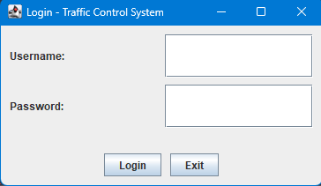
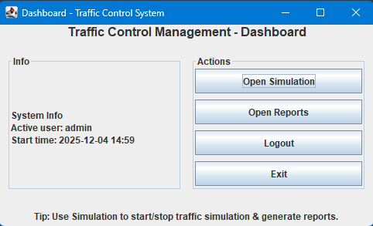
RESULT:
DASHBOARD:
LOGIN PGAE:

Slide 12
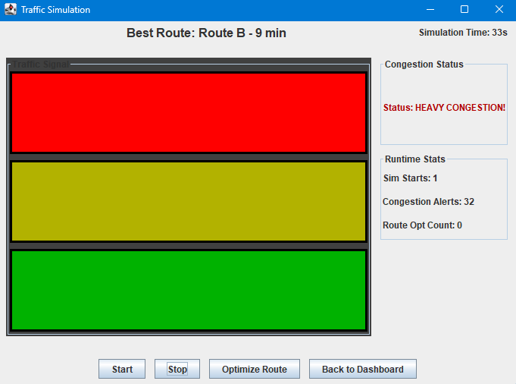
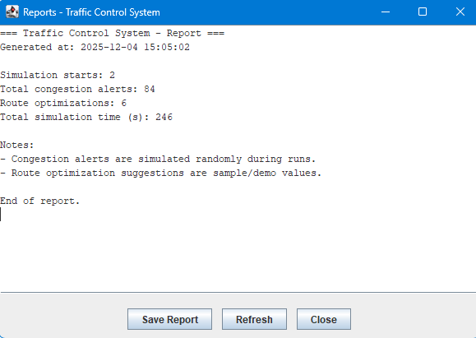
RESULT:
SIMULATION:
REPORTS PAGE:

Slide 13
DISCUSSION
    The system shows how software can help manage and control urban traffic.
    It uses Java AWT and Swing to simulate traffic signals and display real-time changes.
    The simulation engine helps understand how congestion forms and how signal timing affects traffic flow.
    User login and dashboard improve system organization and controlled access.
    The report module helps store and review traffic performance data.
    Even though the model is basic, it demonstrates the concept of smart traffic management.
    The project can be expanded with AI, sensors, and real-time data for a smarter city system.

Slide 14
CONCLUSION
    The Traffic Control Management System effectively demonstrates how software-based control and simulation can enhance real-time traffic monitoring and decision-making.
    Future improvements could include integrating live sensor data, map APIs, and machine learning models to predict congestion trends.
    This project illustrates a foundation for building Smart Traffic Management Systems in urban cities.

Slide 15
Thank You

